Slide 1



Diabetes and Retinopathy Classification: A Multi-Modal Approach
Team Members:
Ajay Tupe
Deepak Deokar
Musharraf Shaikh

Slide 2

Introduction to the Problem
Diabetes and diabetic retinopathy are major global health concerns. Accurate and early detection can save lives and reduce healthcare costs. This project aims to independently develop models to predict diabetes status from structured health data and retinopathy severity from retinal images.

Slide 3
Selected Datasets
Tabular Dataset: Diabetes Health Indicators Dataset
Features: BMI, blood pressure, physical activity, etc.
Target classes: Non-Diabetic, Pre-Diabetic, and Diabetic
Image Dataset: APTOS 2019 Blindness Detection Dataset
Features: High-resolution retinal images
Target classes:
0 - No Diabetic Retinopathy (DR)
1 - Mild
2 - Moderate
3 - Severe
4 - Proliferative DR

Slide 4
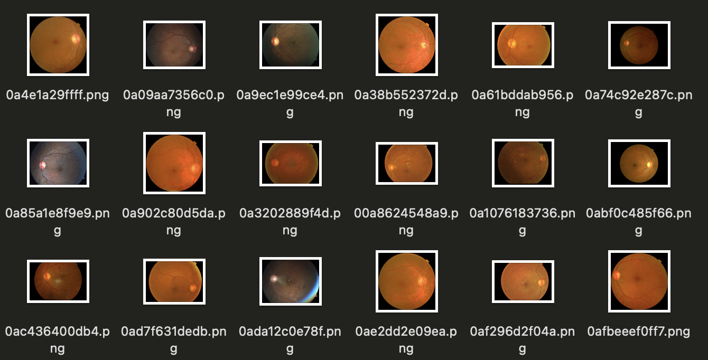
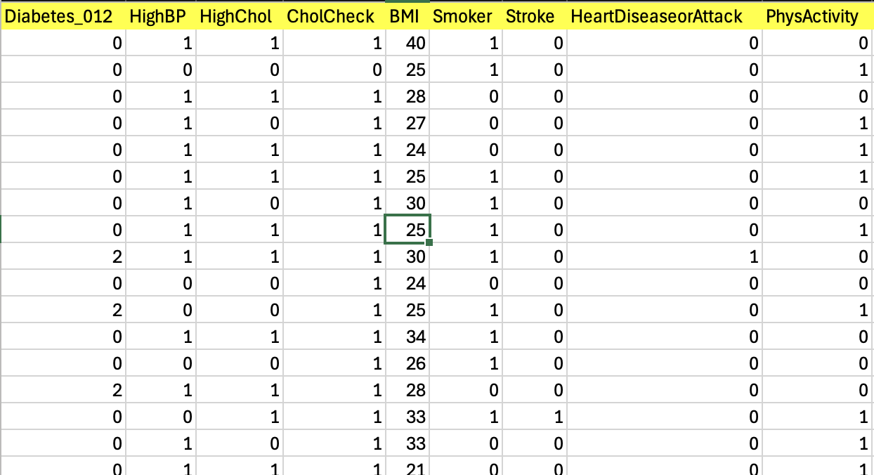
Sample Data Representation
Image Dataset
Tabular Dataset

Slide 5
Methods to be Used for Analysis
Model for Tabular Dataset:
A feed-forward neural network (FFNN) will predict diabetes status using structured health indicators.
Train and evaluate independently for accuracy, precision, and recall.
Model for Image Dataset:
A convolutional neural network (CNN) like ResNet50 will classify retinopathy severity from retinal images.
Train and evaluate independently for multi-class classification metrics.

Slide 6
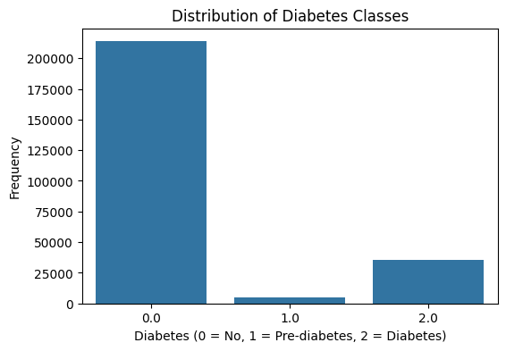
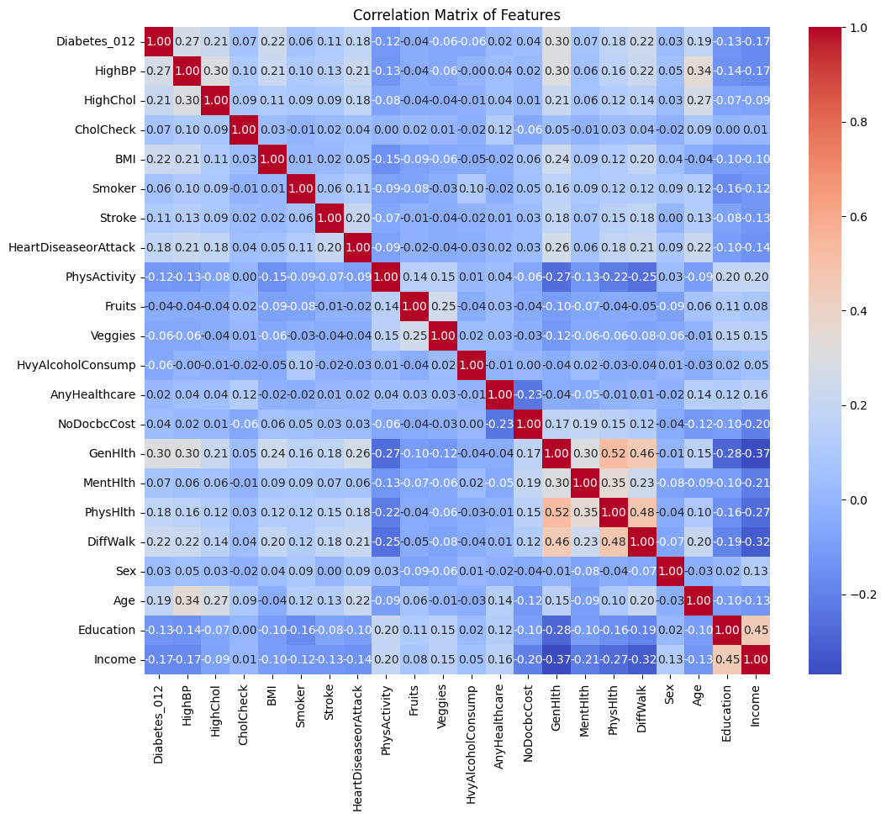
Preliminary Visualizations (Tabular Data)
Target Variable Distribution
Feature Correlation Heatmap

Slide 7
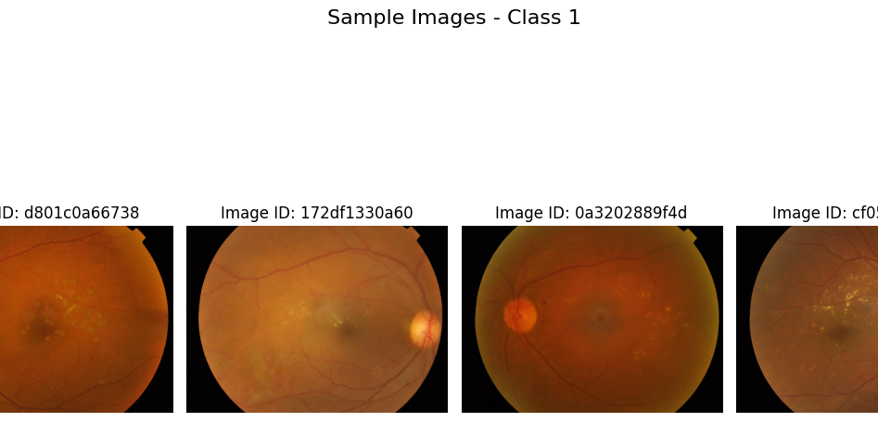
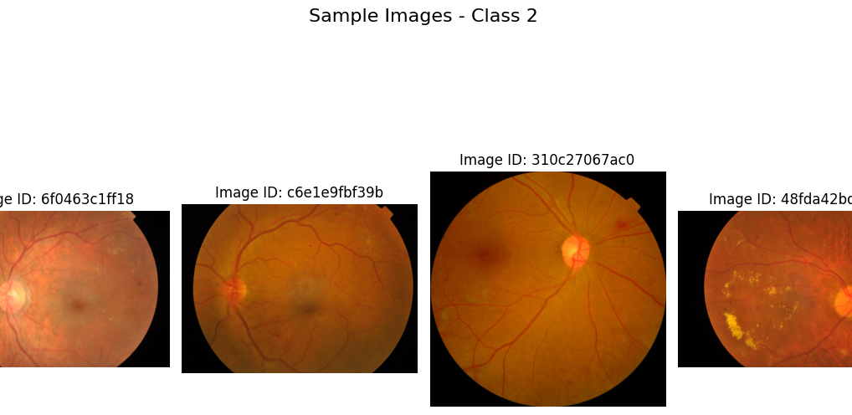
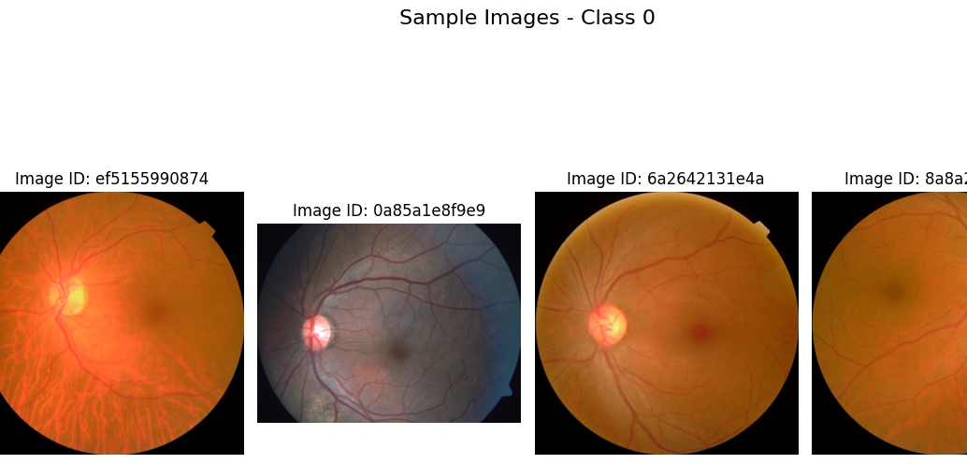
Preliminary Visualizations (Image Data)
Sample Retinal Images By Class

Slide 8
Anticipated Outcomes
Tabular Model:
Accurate classification of diabetes status as Non-Diabetic, Pre-Diabetic, or Diabetic.
Key insights into impactful health indicators.
Image Model:
Accurate prediction of retinopathy severity, aiding in prioritizing patients for medical intervention.
Impact:
Independent models will provide domain-specific insights and improve healthcare decision-making.

Slide 9
Timeline and Next Steps
Timeline:
Data Preparation and Initial Modeling: Complete by mid-November.
Model Optimization and Evaluation: End of November.
Final Analysis and Report Writing: Early December.
Next Steps:
Complete data preprocessing and baseline model training.
Begin hyperparameter tuning and model validation.

Slide 10

Thank you

